Slide 1
C372 Payment Technologies
Week 01
Lesson 01 Introduction to Payments

Slide 2

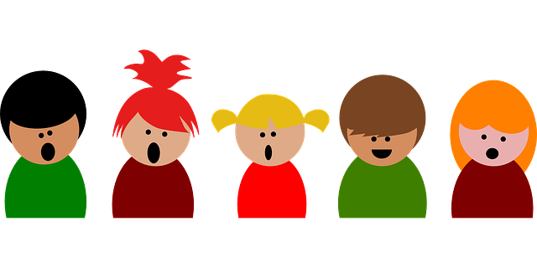

Administrative matters
As you go through the day with your lecturer, there will be activities for you to work on.
Some activities are meant to help you take notes, while others are for you to delve deeper into the topics.
These activities will be mapped in both the slides and worksheet. You should put your answers in the worksheet.
Below are some icons to guide you on what an activity will require you to do.
Answer some questions on your own as you watch a video or listen to your lecturer.
Team discussions
This is a lecturer-led activity. Your lecturer will guide you through an activity step-by-step. Pay close attention!

Slide 3

Lesson Objectives
In this lesson, students should be able to:
Explain what a payment system is.
Describe how payment methods have evolved.
Compare common payment methods and their risks.
Distinguish card-based, A2A and wallet-based payments.
Identify key participants and trace a simplified card-payment flow.
Distinguish authorisation, clearing and settlement.
Note:
Record your responses to all activity questions in your worksheet.
Slides with this icon is for your self-reading

Slide 4

Kahoot Quiz
Your lecturer will host a Kahoot quiz now, this quiz will cover concepts from previous relevant modules.
The quiz today will not be part of your assessment, it is just for revision and also a practice on indicating your name in the correct format for future quizzes that will be assessed.
Please join the Kahoot with your name in the following format:
StudentID_FullName
e.g. 2212345_ChanBobo

Slide 5
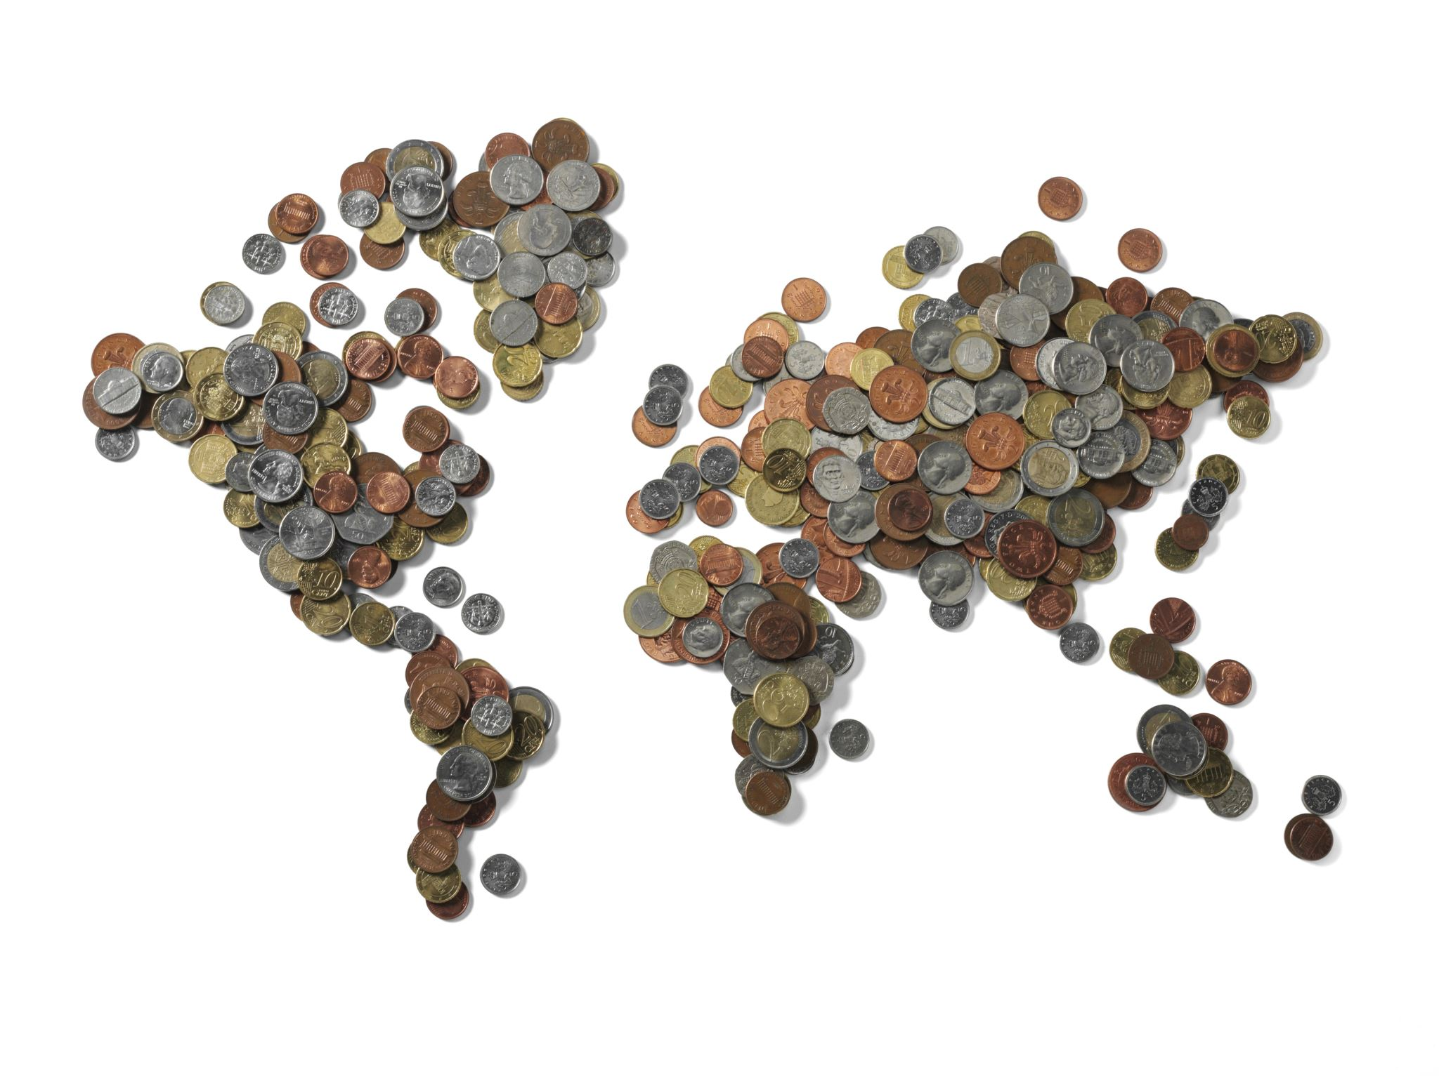
Payment Systems

Slide 6
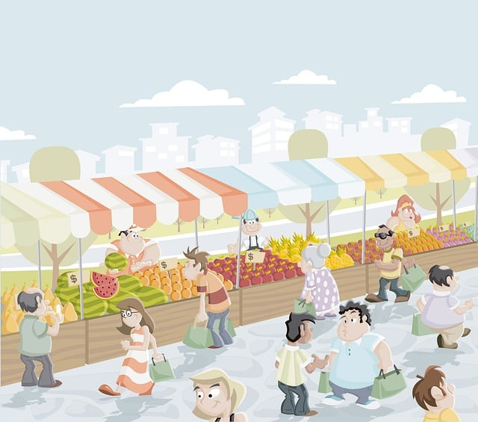
Payment Systems
A payment system is a combination of participants, processes, rules and technologies that enables value to be transferred between a payer and a payee.
They play a crucial role in the functioning of the economy by enabling the exchange of goods and services.

Slide 7
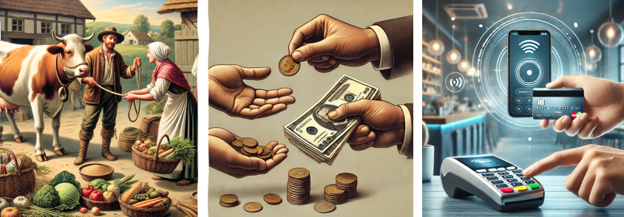
Historical Evolution of Payment Systems
Payment systems have evolved from barter systems, where goods and services were directly exchanged, to the use of coins and paper money, and now to digital and electronic payment methods.

Slide 8
Common Payment Methods
Method | Strength | Limitation | Example
Cash | Immediate and widely understood | Loss, theft and counterfeit risk | Notes and coins
Cheque* | Supports formal payment instructions | Slow processing and fraud risk | Bank cheque
Card | Convenient and widely accepted | Fees, fraud and multi-party processing | Visa
Account-to-account | Near real-time account transfer | Scam, impersonation and erroneous-transfer risks. | PayNow
Digital Wallet | Convenient experience | Acceptance and risks depend on the wallet and its underlying payment rail. | GrabPay
*As of 1 January 2026: All banks have stopped the issuance of new SGD corporate cheque books, bulk cheque services and cheque self-printing services
From 1 January 2027: All banks will stop processing SGD corporate cheques
Notes:
Why people using Paynow instead of using bank transfer?
= paynow is easier and universal due to the phone number the wrapper of the detail of the customer.

Slide 9

Exercise 1
Scenario:
You receive a digital payment request. Before approving it, what could go wrong?
In your teams, identify three risks and suggest one safeguard for each.
Risks | Safeguards
Impersonating | Double check over the details, whether friends or someone we know
The Request send twice | Check the transaction history whether they payment is already made
Wrong Amount | Double check the amount
Post your response in your class MSTeams

Slide 10
How Digital Payments Move: Three Architectures
Architecture | Example | Simplified movement
Card-based | Visa or Mastercard card | Merchant → card network → issuing bank
Account-to-account(A2A) | PayNow | Payer account → payment infrastructure → recipient account
Wallet-based | GrabPay or stored-value wallet | Wallet balance or linked funding source → merchant
*NFC and QR codes describe how payment information may be presented or exchanged. They do not always identify the underlying payment rail.

Slide 11
Exercise 2
What are some of the payment methods or technologies you have used personally? (e.g. Used YouTrip when I went Japan, PayNow at hawker stall)
Share and discuss with your team. Note down in your worksheet, what your teammates used.
Member | Payment method/App used | Card, A2A or wallet? | Payer | Payee | Other participant or provider
Randy
Post your response in your class MSTeams

Slide 12
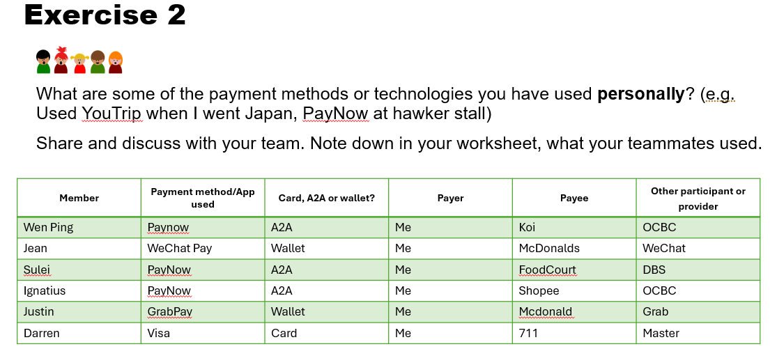
SUGGESTED answer

Slide 13
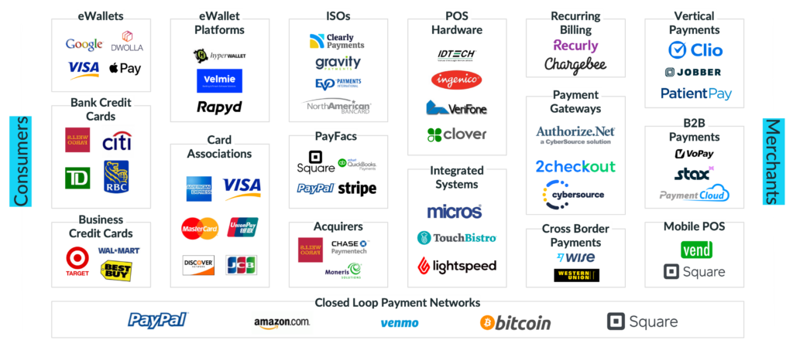
Overview of the Payments Ecosystem
The payments ecosystem includes processes, technologies, and participants facilitating the transfer of value effectively.

Slide 14
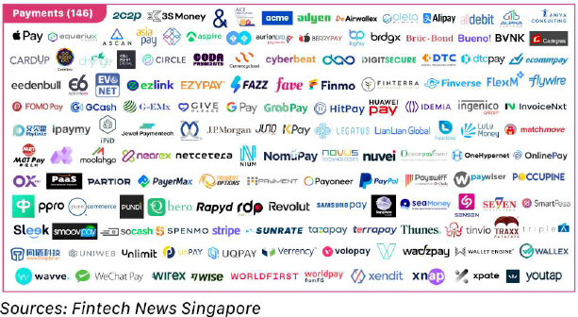
Payments Ecosystem in Singapore

Slide 15
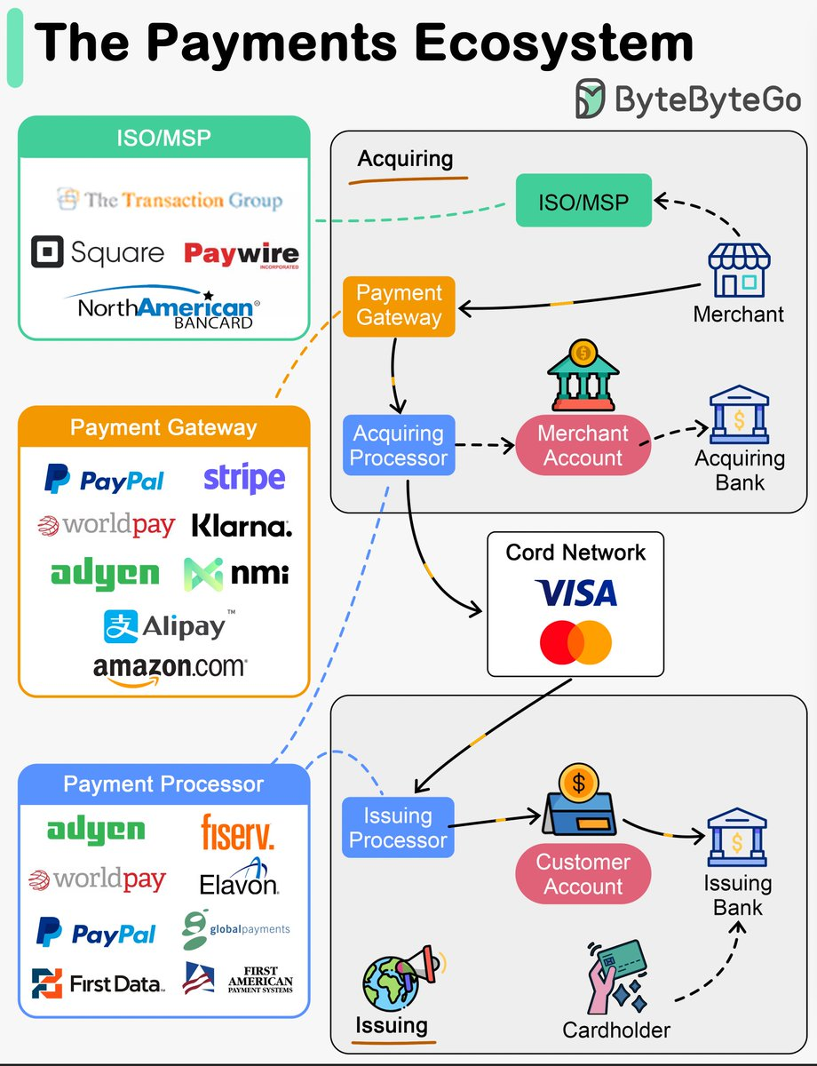
Key players
Six roles commonly found in a card-based transaction.
Customer/Payer: initiates the payment
Merchant/Payee: accepts payment
Gateway/Payment Service Provider: transmits and manages payment requests
Acquirer: supports the merchant’s acceptance of payment
Network: routes card-payment messages
Issuer: approves or declines on behalf of the customer
https://x.com/alexxubyte/status/1755992712229368299

Slide 16
A Payment Does Not Happen All at Once
1. Authorisation
2. Clearing
3. Settlement
Can this transaction proceed?
Transaction details are exchanged.
Funds are transferred later.
Authorisation
The issuer decides whether the transaction may proceed.
Clearing
Transaction information is exchanged between the relevant parties.
Settlement
Funds are transferred between the participating institutions.
When the customer sees “Payment successful,” have the funds necessarily completed final settlement?

Slide 17
Exercise 3
Scenario: A student buys a concert ticket online using a DBS Visa card.
a) Identify the various players
Player | Answer
Customer | Student
Merchant | The ticket seller
Issuer | DBS
Gateway | VISA(Payment gateway used by the platform)
Acquirer | VISA( merchant acquiring institution)
Card Network | DBS(Visa)
Post your response in your class MSTeams

Slide 18
Exercise 3
Scenario: A student buys a concert ticket online using a DBS Visa card.
b) What should the payment flow look like?
Student
Merchant
Gateway/Acquirer
Card network
Issuing Bank
Post your response in your class MSTeams

Slide 19
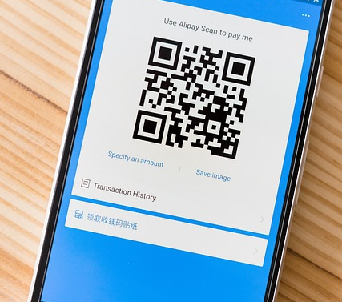
Emerging Trends in Payments
Emergence of BNPL: Buy Now, Pay Later services enhance consumer access to goods by deferring payment, influencing purchasing decisions.
Popularity of P2P Apps: Peer-to-peer payment applications simplify transactions between individuals, fostering increased adoption among diverse consumer demographics.
Real-Time Payment Impact: The rise of real-time payments accelerates transaction completion, reshaping consumer expectations for immediacy and convenience.

Slide 20
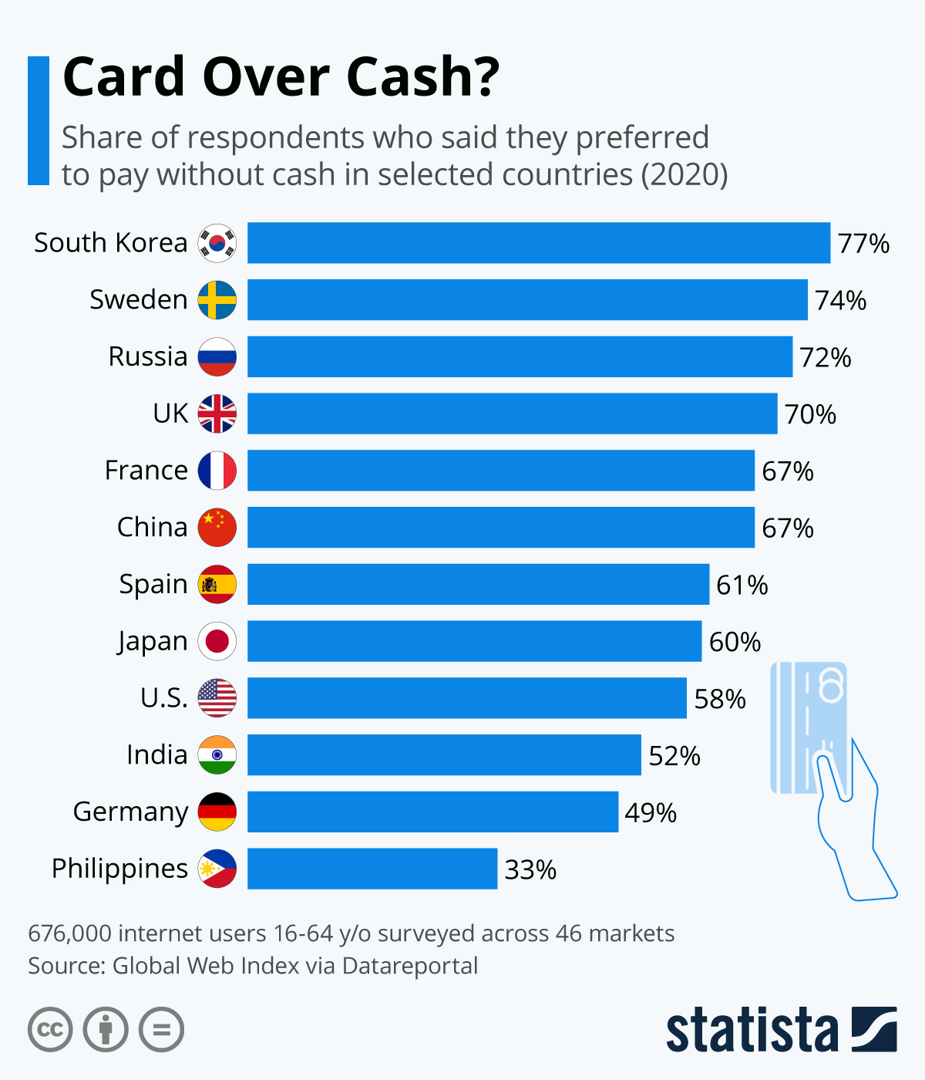
Global Payment Systems Trends
Card Dominance in North America: Credit and debit cards dominate payment methods, reflecting consumer preference for convenience and built-in fraud protections.
Contactless Trends in Europe: Europe exhibits high contactless payment adoption due to infrastructure advancements and consumer demand for swift transactions.
https://www.statista.com/chart/23950/preference-cashless-payment-selected-countries/

Slide 21
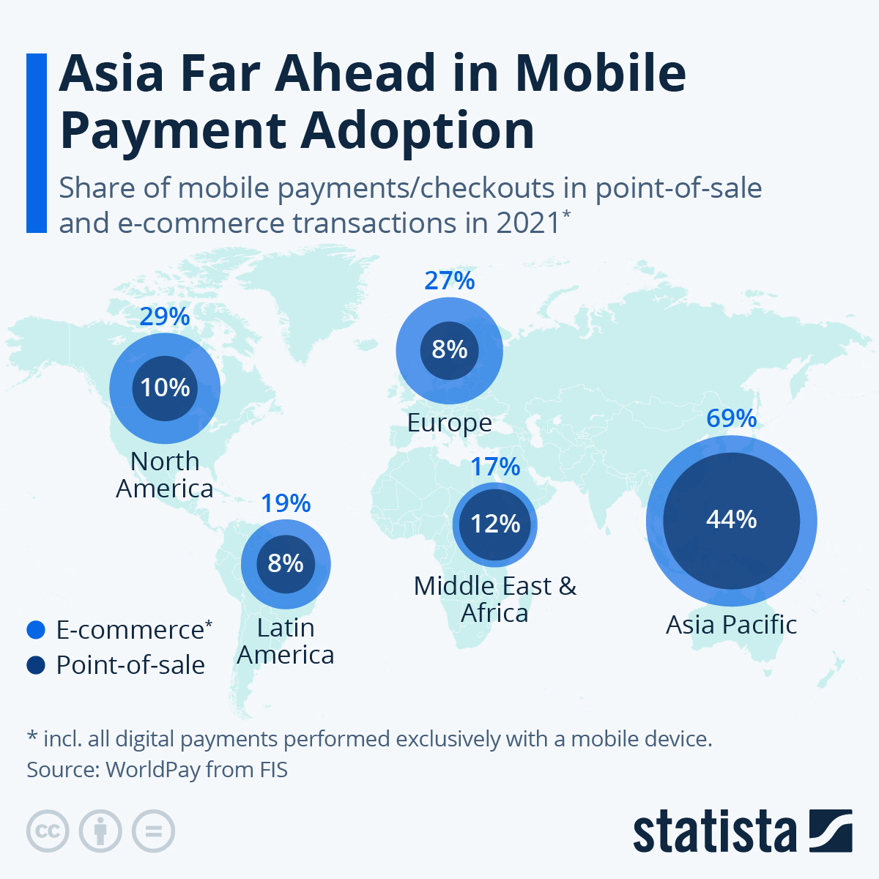
Global Payment Systems Trends
Mobile Wallets in Asia: Asia leads in mobile wallet utilization, integrating digital payments into daily life with robust app ecosystems.
https://www.statista.com/chart/28128/mobile-payments-around-the-world/

Slide 22
CA1 Assessment
Weeks 1 - 5

Slide 23
CA1 Assessment
CA1 Assessment
  Kahoot Quiz (20%)
  PetCareApp project (80%)
    Your development work from Weeks 1–5. See the next slide for the submission checklist.

Slide 24
CA1 SA3.0 Submission
Deadline: 20 November 2026, 2359 in SA3.0
Submit your PetCareApp work from Weeks 1–5:
  Final code - Your completed Week 5 PetCareApp code.
  Development documentation - Diagrams, documentation and other development artefacts.
  AI Interaction Journal - A record of how you used AI during CA1.
  App walkthrough video* - 3 - 4 minutes maximum
    Demonstrate the key features.
    Explain one development decision.
    Show one example of how you checked or improved an AI suggestion.
*Screen recording with narration only. No camera or editing required.
Your knowledge and understanding will be assessed through your submitted work, app walkthrough video and your lecturer’s observations during in-class activities, including your explanations of code, development decisions and problem-solving.
Presentation and communication skills are for practice and will not be graded in CA1.

Slide 25
Installations and Setup*
Checking your setup - C372_W01_L01_Installation_Setup.pptx
*If you still have your software from C237, you should have most of the software required already

Slide 26

Summary
In this lesson, we have learnt about…
Explain what a payment system is.
Describe how payment methods have evolved.
Compare common payment methods and their risks.
Distinguish card-based, A2A and wallet-based payments.
Identify key participants and trace a simplified card-payment flow.
Distinguish authorisation, clearing and settlement.

Slide 27
Submissions
Worksheet (Individual)
Upload your deliverables to POLITEMALL even if it is incomplete before the next session.
You can resubmit by 2359 if there are updates.

